Slide 1
Project
Deep Learning
Title
Unmasking The Fake Faces Using Deep Learning Techniques
Team Members:
Saranya, Degapudi

Slide 2
Table of Content:
Introduction
Data Overview
Implemented Algorithms
Code Explanation
Conclusion

Slide 3
Introduction
Background:
Nowadays deep-fake has become a major concern as they are creating fake videos and images by using AI.
Even though we had the technology, it was usually misused or used illegally or for evil purposes instead of for good purposes like teaching and enjoyment.
Problem Statement:
The main objective of this project is to create a deep-learning model by using CNN, LSTM, and Res Next 50 models by using packages to detect the accuracy of whether the video is fake or real.

Slide 4
Data Overview
Sources:
Deepfake Detection Challenge organized by Kaggle in collaboration with Facebook.
Technische Universität München (TUM).
Nanyang Technological University (NTU).

Slide 5
Data Overview
Dataset Names:
FaceForensics++Dataset
Celeb-DF Dataset
Deepfake Detection Challenge(DFDC)Dataset
Labels:
Video (Real==1,Fake==0)

Slide 6
Data Overview
Dataset Quantity:
Total videos =6450
FaceForensics++Dataset=1989
Celeb-DF Dataset=1168
Deepfake Detection Challenge(DFDC)Dataset=3293
Dataset Splitting:
Train Test split(80-20)
Training Videos:5141
Validation Videos:1286

Slide 7
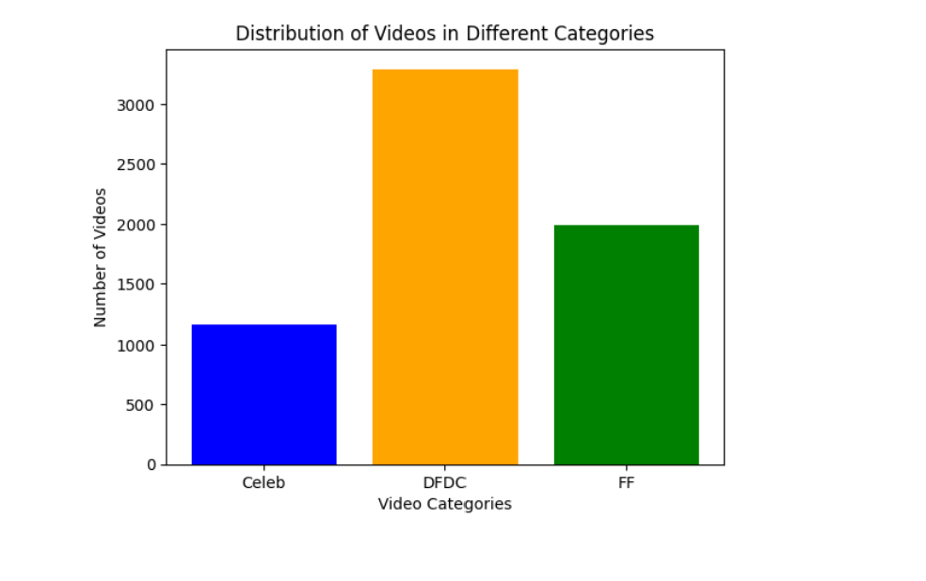
Data Overview
Ratio Of Classes:
TRAIN DATA :
Real:2641
Fake:2500
TEST DATA :
Real:660
Fake:626

Slide 8
Implemented Algorithms
1. Convolutional Neural Network:
Multi convolutional layers, pooling, and nonlinear functions applied to design and train model for prediction.
The convolution neural network's layers will be equivariant to translation because of parameter sharing. It states that any changes we make to the input will correspondingly affect the outcome.
Multiple layers work together to find the best match layer in order to forecast the image class. This procedure is repeated until no more improvement is possible.

Slide 9
Implemented Algorithms
2. LSTM:
Deep learning uses long short-term memory (LSTM), an artificial recurrent neural network (RNN) architecture. LSTM features feedback connections, in contrast to conventional feedforward neural networks. It can process whole data sequences (like audio or video) in addition to individual data points (like pictures).
To address the temporal dependencies inherent in sequential data, the model integrates an LSTM layer.
The LSTM layer excels at modeling sequential patterns, capturing long-term dependencies across different time steps.

Slide 10
ARCHITECTURE
Pre-Trained ResNeXt50 Model:
The model integrates the ResNeXt50 architecture, a powerful variant of ResNet, renowned for its effectiveness in image-related tasks.
By loading pre-trained weights, the ResNeXt50 module serves as a potent feature extractor, adept at discerning high-level patterns and representations within input images.

Slide 11
ARCHITECTURE
Activation and Regularization:
LeakyReLU Activation:
The architecture employs the Leaky Rectified Linear Unit (LeakyReLU) activation function.
LeakyReLU introduces a slight negative slope during the negative input range, enhancing the model's capacity to learn complex, non-linear mappings.
Dropout for Regularization:
A dropout layer with a rate of 0.4 is applied to prevent overfitting.
During training, dropout randomly deactivates a fraction of neurons, promoting model robustness and preventing reliance on specific pathways.

Slide 12
CONCLUSION
The FaceForensics++, Celeb-DF, and DFDC datasets collectively provide a robust foundation for the development and evaluation of deepfake detection models. Their diversity in manipulation techniques, inclusion of real-world scenarios, and widespread adoption in the research community contribute significantly to advancements in deepfake detection technology. The final model has the combination of both CNN and LSTM worked best. It captures the features while also the sequence in the video. Finally, while combining both accuracy is 98.51%.

Slide 13
THANK YOU

